Slide 1


E-Learning Project
Sparsh Rawal (182198)

Slide 2


Project Aim
To create a simple web application in order to understand the Front-End and Back-End Java technology.
To understand the working of JDBC and MySQL.
To implement the project using Maven Build tool and Eclipse IDE on Tomcat Server.
To develop Front-End web pages using JSP, Web servlet and HTML, CSS, Bootstrap in order to Implement CRUD on the Tables.

Slide 3
Back-End
MySQL database was created and used for storing and retrieving information.
Core JAVA was used implementing the DAO Design Pattern along with the JDBC API to connect with the Database.
Tables were created and some fundamental queries were implemented.

Slide 4
Front-End
JSP along with HTML,CSS and Bootsrtap was used to create create web-pages to enable interaction with the Back-End.
Web-Page requests were handled with the use of web-servlets by using the GET and POST methods.
Various forms for Login and Registration were created in order to insert and update records in the database.

Slide 5
Integration
The Front-End and Back-End was integrated using Maven Build tool by adding the Back-End dependency to the Front-End.
Eclipse IDE was used to develop and integrate the Front-End and Back-End.
Tomcat server was used to view the developed web page and test the Java Web-Servlet Functionalities.

Slide 6
Technologies Leant
Core Java DAO Design Pattern
JDBC Connections and statements used.
MySQL Queries.
JSP Webpage integration with Web-Servlet.
HTML, CSS and Bootstrap.

Slide 7
Screenhots

Slide 8

Main Landing Page

Slide 9
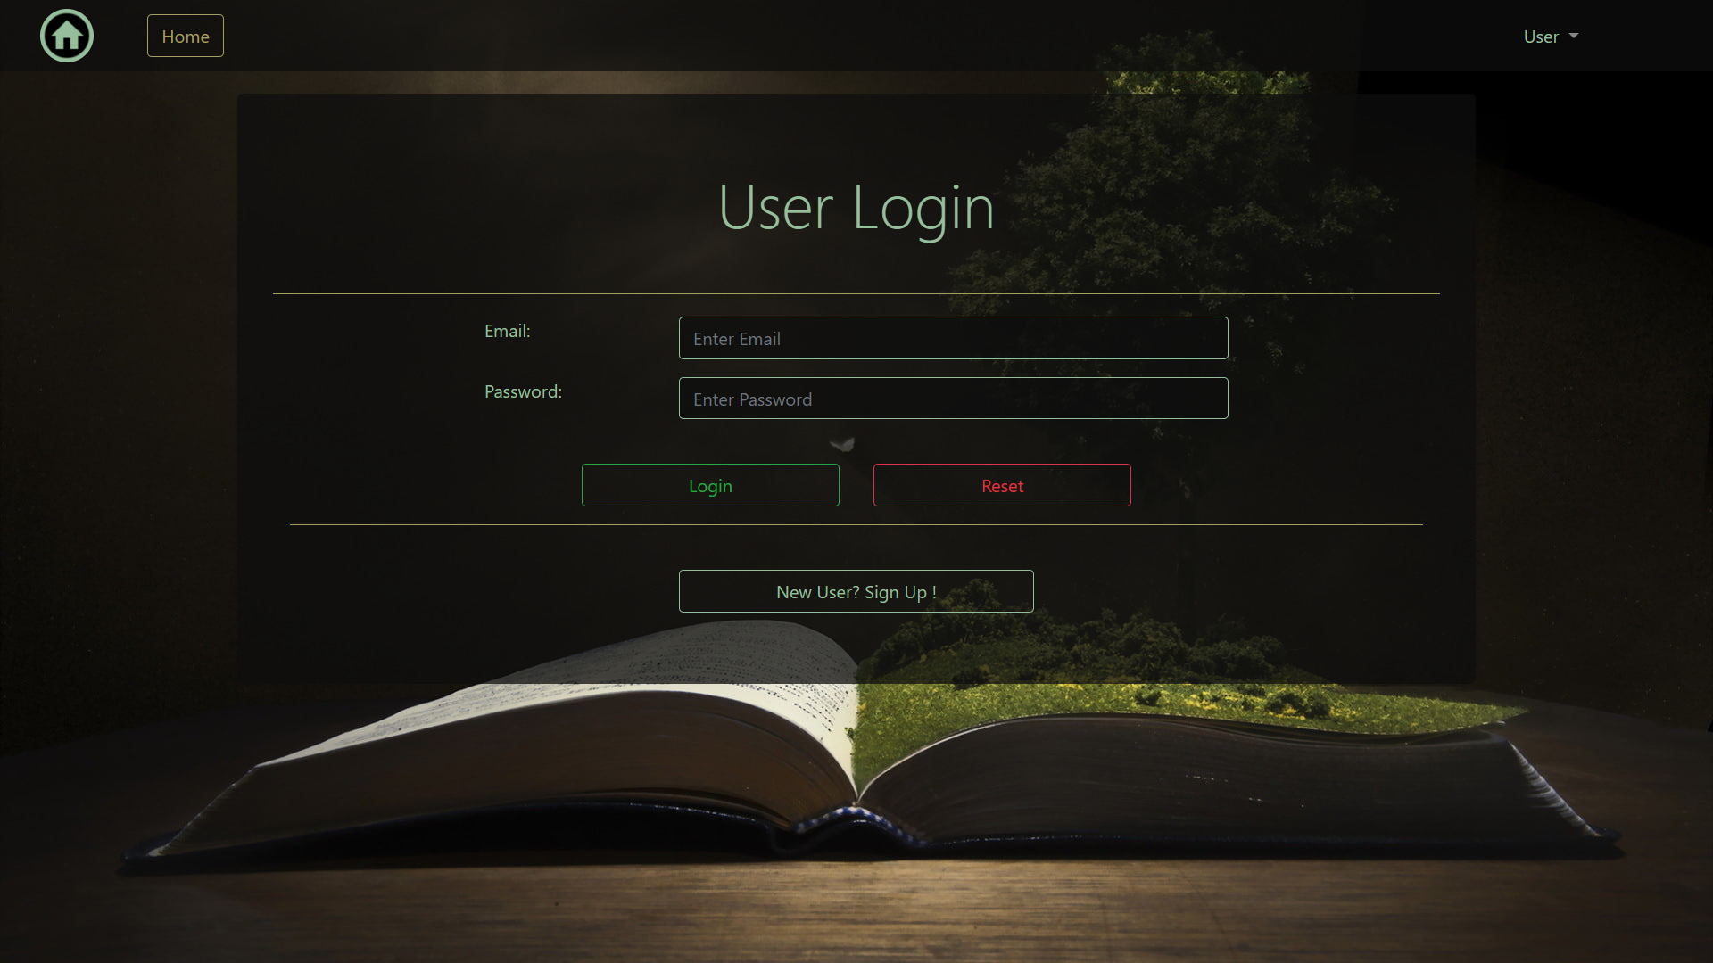
User Login Page

Slide 10
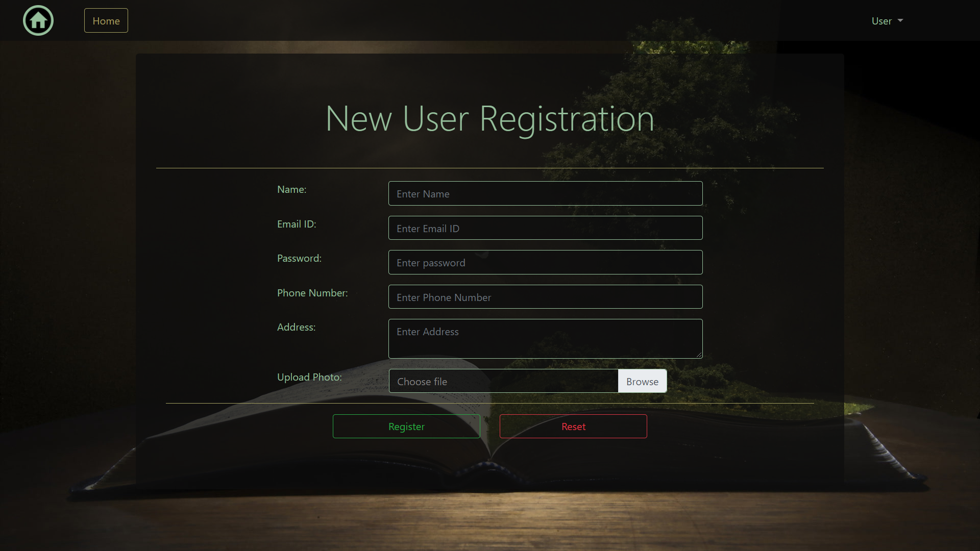
New User Registration Page

Slide 11
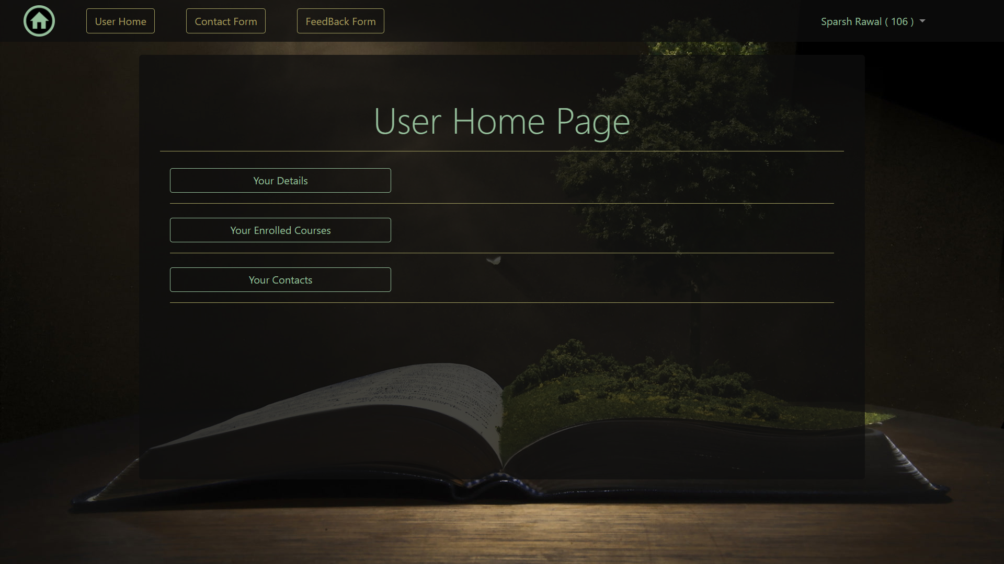
User Home Page

Slide 12
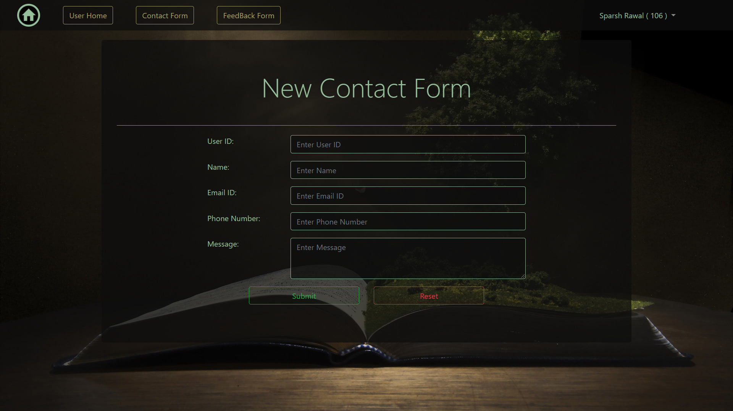
New Contact Form

Slide 13
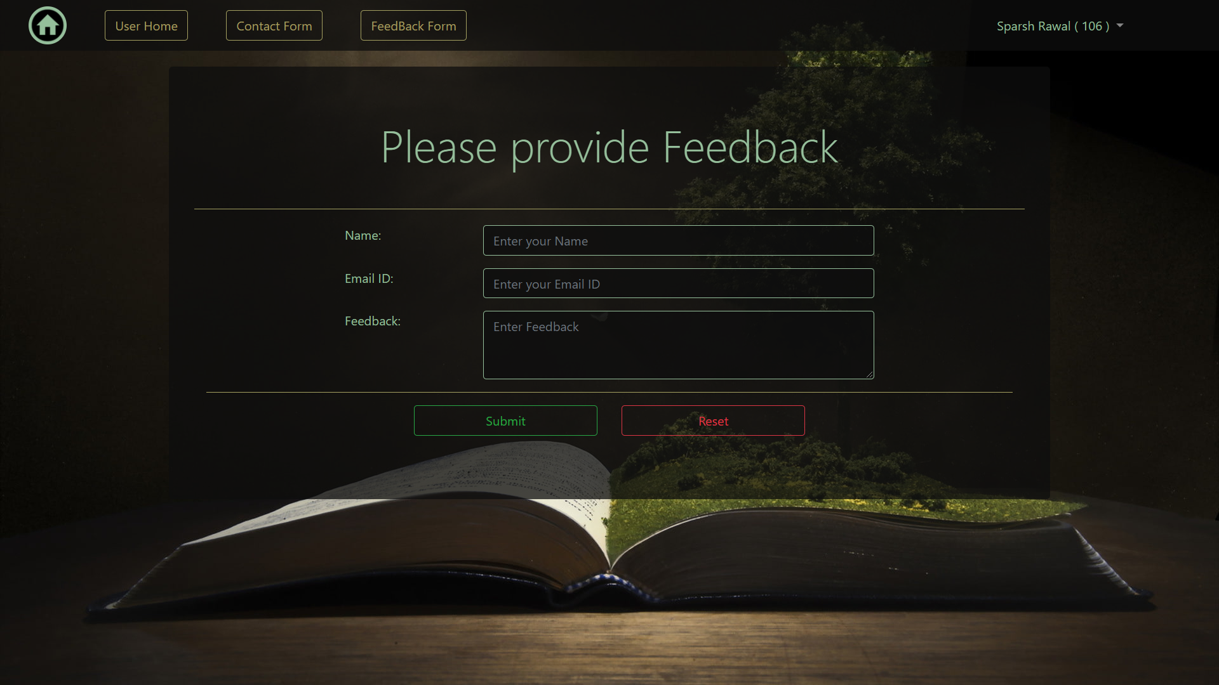
Feedback Form

Slide 14
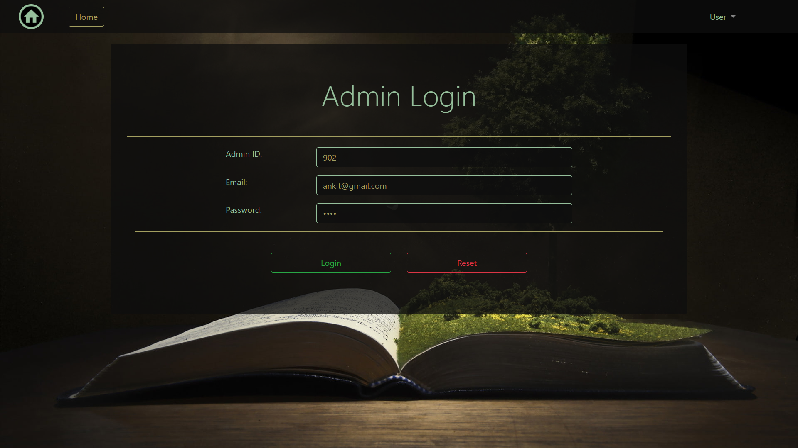
Admin Login

Slide 15
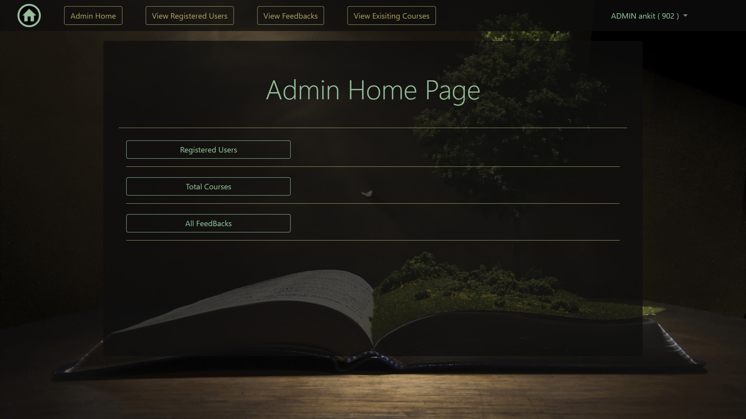
Admin Home Page

Slide 16
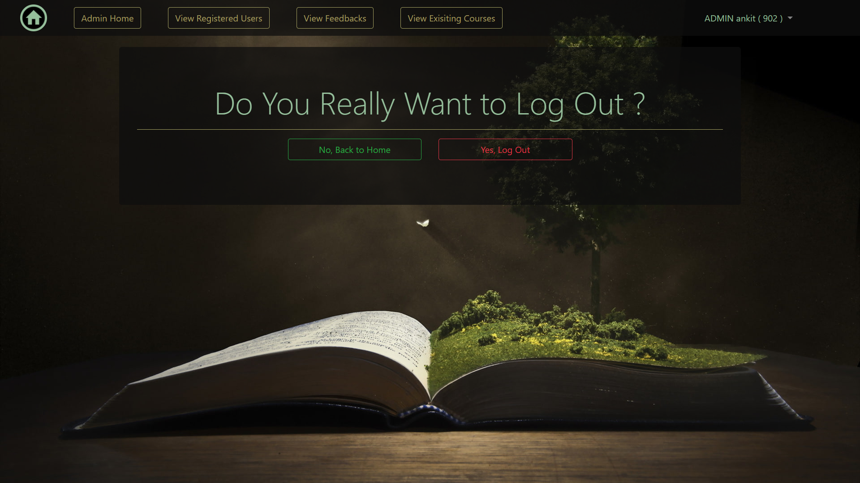
Logout Page

Slide 17

Success Page

Slide 18
Thank You !

